Slide 1


Slide 2
Construction Administration
Clint Bishop, P.E.

Slide 3
Construction Administration
104.02.D. Significant Changes in Character of the Work (2)
107.15 Contractor’s Responsibility for Work
108.07 Failure to Complete on Time
109.05.C.9 Professional and Specialized Work
619 Field Office
PN 520 Fuel Price Adjustment
Notes:
108.02 Partnering revisions are minor. Our dispute resolution coordinator, Nathan Fling, will discuss these revisions. The most significant is a requirement for the district to provide a copy of their step 2 documents to the contractor prior to the hearing. The Step 2 hearing will be scheduled to allow 14 days for the contractor to review these documents.

Slide 4
104.02.D. Significant Changes in Character of the Work
Minimum change order amount increased from $400 to $800
If the increase in quantity of any unit price Contract Item exceeds 25 percent of the estimated quantity, and the total of all adjustments for all Contract Items is more than $8400, then after a final determination of final quantities according to 109.12.C, the Engineer will adjust the unit prices for the Contract Items exceeding 25 percent of the estimated quantity. The factor obtained from Table 104.02-3 is only applied to the quantity exceeding 125% of the estimated quantity. by multiplying the bid unit price by the factor obtained from Table 104.02-3
Notes:
If the increase in quantity of any unit price Contract Item exceeds 25 percent of the estimated quantity, and the total of all adjustments for all Contract Items is more than $8400, then after a final determination of final quantities according to 109.12.C, the Engineer will adjust the unit prices for the Contract Items exceeding 25 percent of the estimated quantity. The factor obtained from Table 104.02-3 is only applied to the quantity exceeding 125% of the estimated quantity. by multiplying the bid unit price by the factor obtained from Table 104.02-3

Slide 5
104.02.D. Significant Changes in Character of the Work – con’t
A quantity underrun is defined as follows:
1. the estimated quantity of a contract item exceeds four units, and
2. If the decrease in quantity of any unit price Contract Item exceeds 25 percent of the estimated quantity, and
3. the total of all such adjustments for all Contract Items is more than $800.
Tthen after the determination of final quantities according to 109.12.C, the Engineer will adjust the unit prices for the affected Contract item by multiplying the bid unit price by the factor obtained from Table 104.02-2.
Notes:
Added at the request of the Industry. The addition or deletion of one item with an original quantity of four can automatically adjust the final quantity by 25%.

Slide 6
104.02.D. Significant Changes in Character of the Work – con’t
A quantity overrun is defined as follow:
1. the estimated quantity of a contract item exceeds four units, and
2. If the increase in quantity of any unit price Contract Item exceeds 25 percent of the estimated quantity, and
3. the total of all such adjustments for all Contract Items is more than $800.
Tthen after a final determination of final quantities according to 109.12.C, the Engineer will adjust the unit prices for the Contract Items exceeding 25 percent of the estimated quantity. The factor obtained from Table 104.02-3 is only applied to the quantity exceeding 125% of the estimated quantity.
Notes:
Added at the request of the Industry. The addition or deletion of one item with an original quantity of four can automatically adjust the final quantity by 25%.

Slide 7
107.15 Contractor’s Responsibility for Work
In the event that the Engineer determines that damage to completed permanent items of Work results from traffic using a substantially completed section of Roadway, the Department may compensate the Contractor for repair of the damage as authorized by Change Order. To receive compensation for the damage the Contractor must meet the following requirements.
A. Notify the Engineer of each occurrence of damage in writing within 10 Calendar Days.
B. Contact the local law enforcement agency to determine if the accident was investigated and a report filed. If an accident report was filed, obtain the report and notify the motorist, and copy their insurance company, via registered mail that the motorist is responsible for the cost of damage repairs.
Notes:
Administrative law – Two year statue of limitations to file a claim
IR 270 project – many claims submitted by contractor to motorist, insurance company or District for reimbursement well after two years since the accident
Not a good faith effort

Slide 8
107.15 Contractor’s Responsibility for Work – con’t
If the motorist does not respond within 30 days, make a second attempt to contact the motorist and copy the insurance company via registered mail.
C. If no response is received from the motorist or insurance company within 30 days, send a letter to the Engineer within eighteen months of the event and include documentation of good faith effort to seek recovery from responsible parties.
D. The Department will make an adjustment according to 108.06 and 109.05 to compensate the Contractor for the added costs and delays, if any, resulting from repairing damaged Work.
If there is no accident report on file and no means of identifying the guilty motorist, the Contractor will likewise be compensated to repair the damaged Work.

Slide 9
108.07 Failure to Complete on Time
Table 108.07-1 SCHEDULE OF LIQUIDATED DAMAGES
Original Contract Amount (Total Amount of the Bid) |  | Amount of Liquidated Damages to be Deducted for Each Calendar Day of Overrun in Time
From More Than | To and Including
$0.00 | $500,000 | $400500
$500,000 | $2,000,000 | $6001,000
$2,000,000 | $10,000,000 | $9001,500
$10,000,000 | $50,000,000 | $1,4002,600
Over $50,000,000 |  | $2,9003,200

Slide 10
109.05.C.9 Professional and Specialized Work
109.05.C.9. Professional and Specialized Work. The following work, when performed by a firm hired by the Contractor, is paid at the reasonable and fair market invoiced cost plus 8% on the first $10,000 of work and 5% for work in excess of $10,000plus a 5 percent markup. The markup is limited to $10,000 for all the work performed by the firm.
Notes:
109.05.C.9. Professional and Specialized Work. The following work, when performed by a firm hired by the Contractor, is paid at the reasonable and fair market invoiced cost plus 8% on the first $10,000 of work and 5% for work in excess of $10,000plus a 5 percent markup. The markup is limited to $10,000 for all the work performed by the firm.
This would apply to:
Surveying.
Engineering design.
Specialized work that is not normally part of a Department Contract and is not normally subject to prevailing wage.
Installation, periodic maintenance, and removal of traffic control devices under Item 614 performed by a traffic control service or rental company, provided the workers are not on the Project full-time. Maintenance of Traffic services performed by LEO.
Other professional or specialized work not contemplated at the time of Bid.
Provide documentation showing payment for professional and specialized Work.

Slide 11
619 Field Office
Allow Type B field offices to have the same printer/copier/scanner as the Type C field offices
Allow all field offices to have the same internet service connection as the Type C office (where available)
Deletion of cure box requirement (Moved to Item 511.04 Concrete for Structures)
Notes:
The Division of Construction Management has an e-Construction initiative to bring more technology to the field and create a paperless construction environment. Every District now has an electronic document management system. This system stores all construction documents electronically and makes them accessible to the project, the District, the Contractor, Central Office and FHWA. This places documents on a secure SharePoint website to be accessible for all parties in the contract. This greatly reduces the need for paper copies and postal mail service. The most current version of a document would be at your fingertips during discussions. Currently, all field offices have a multifunction copier/printer/scanner. One of the revisions would allow Type B and Type C field offices to print/copy/scan up to 11”x17” (half-plan size sheets). These devices have decreased in cost and can be partially offset with the unit bid price for these field offices.

Slide 12
PN 520 Fuel Price Adjustment
The Industry approached our office about a modification to PN 520 Fuel Price Adjustments. Over the last several years, most all of the asphalt plants have converted from diesel fuel to natural gas.
PN 520 Fuel Price Adjustment dated 10/17/2014 indicated that each cubic yard of flexible base and pavement requires 4.5 gallons of diesel fuel to mix, transport and place.
PN 520 Fuel Price Adjustment dated 09/09/2015 was revised to indicate each cubic yard of flexible base and pavement requires 1.7 gallons of diesel fuel to mix, transport and place.
Notes:
The industry is using less diesel fuel to mix, transport and place a cubic yard of asphalt.
The “line in the sand” agreed to with Industry is August 1, 2015. Placed prior, use old factor. Placed on or after, use new factor.
This proposed change is supported by the NCHRP Report 744 Fuel Usage Factors in Highway and Bridge Construction dated 2013

Slide 13
Construction - Geotechnical
Steve Slomski, P.E.

Slide 14
General Changes
RAP (Reclaimed Asphalt Pavement) replaces
RACP (Reclaimed Asphalt Concrete Pavement)
Emphasize when ODOT is responsible for compaction testing:
“Unless otherwise specified in the Contract Documents, the Engineer will perform all compaction tests according to Supplement 1015.”
Contractor always responsible for 611 and 840

Slide 15
Item 201 Clearing And Grubbing
Removed listing the restrictions for material movement from quarantined areas associated with destructive insects (e.g., emerald ash borer, Asian longhorned beetle), due to it becoming outdated
Added Ohio Department of Agriculture web address for the listing of current restrictions

Slide 16
Items 205 & 206 Chemically Stabilized Embankment & Subgrade
Removed Lime Kiln Dust (LKD) as an approved material for chemical stabilization
LKD was not a successful economical alternative to cement
LKD may still be used as a drying agent for moisture control of wet embankment material (203.07.A)

Slide 17
Item 206 Chemically Stabilized Subgrade
Submit the construction procedure, for phased work, to ensure full depth and continuity of subgrade stabilization across phase interfaces
Clarified that air temperatures must be above 40 °F for the curing period
Discontinued allowing concrete curing compound (705.07 Type 2) to be used for the curing coat

Slide 18
Item 208 Rock Blasting
Deleted use of the term trim blasting as a synonym for cushion blasting
  Trim blasting, still used in SS 862 Rockfall Protection, refers to low energy removal of large rock blocks or overhangs
Changed a water quality test parameter to sulfate
Removed a reference to a specific lightning detector model

Slide 19
Supplemental Specification 840 Mechanically Stabilized Earth Walls
Added two new systems
  Tabbed (punched) steel strips (Sanders MSE)
  Modular block with geogrids (Redi-Rock Positive Connection)
Revised design submittal requirements:
  Competent individuals to prepare and check the design calculations and drawings
  Preparers and checkers to initial each sheet, and shall be different individuals
  One Ohio P.E. to sign, seal, and date design calculations and drawings submittal

Slide 20
Supplemental Specification 840 Mechanically Stabilized Earth Walls
Added emphasis to design requirements, which were sometimes not followed by the suppliers
  “Use only one soil reinforcement system for the entire length of the retaining wall.”
  → mixing steel strips and steel ladders
  “Aesthetic treatment limits extend from the top of the leveling pad to the top of the uppermost facing panel.”
  → plain finish panels below groundline, behind barriers,
  and behind coping

Slide 21
Supplemental Specification 861 Geogrids for Subgrade Stabilization
Required that geogrids are to be punched and drawn polypropylene
Modified geogrid material properties to qualify more suppliers
Added Designer Guidance to include an Alternate design to be able to use a proprietary geogrid

Slide 22
Supplemental Specification 862 Rockfall Protection
Added a new excavation pay item for removal and disposal of material from the rock slope, which include both previously fallen and scaled material
Method of measurement determined during plan preparation by plan note, either:
  By a three-dimensional volume method
  By the “measured in vehicle” method

Slide 23
Supplement 1015 Compaction Testing of Unbound Materials
Documentation requirements for technicians
  Use separate forms for each material/pay item
  Fill out forms completely
  Provide phase number, test location (station, offset, wall number)
  Provide gauge readings and backup calculations for trench or moisture corrections
Require minimum weight of 30 lbs for the concrete block used for Proctor mold compaction

Slide 24
Supplement 1015 Compaction Testing of Unbound Materials
Guidance on performing Test Sections
  Use production equipment and materials
  Construct a new test section when the material changes or supporting material changes
  For Method A, use only the OMC from the laboratory moisture-density curve
  For Method B, use new material on a new adjacent area for each moisture content section
Maximum dry density from the test section is used for compaction control

Slide 25
Supplement 1120 Mixture Design For Chemically Stabilized Soils
Sulfate content now determined by new Supplement 1122, which is similar to TEX-145-E method
“For phased construction, collect in-place soil samples from locations distributed across the treated area of each phase…”
Additional reporting requirements
  Geographic coordinates of sample locations
  Station limits and construction phase of treatment recommendations

Slide 26
Construction – Pavements
Craig Landefeld, P.E.

Slide 27
Item 401 - Asphalt Concrete Pavements - General
401.11 Hauling
  Added language to require QCP to address loading of haul trucks to eliminate segregation of the mixture.
  Clarified prohibition of truck cleanout ahead of paver.
401.12 Anti Segregation Equipment
  MTV/MTD or Remix Paver requirements added.
  Bid items established in 441/442
  Surface & Intermediate Courses for Priority System.
  1000LF Test Strips required to evaluate mat for each JMF.
  No visible physical segregation & ΔTemp ≤ 35°F

Slide 28
Item 401 - Asphalt Concrete Pavements - General
401.15 Spreading Finishing & Night Work
Do no comingle multiple JMFs in the same paver.
401.17 Joints
Construct longitudinal joints using string line or other controls as a point of reference to provide a straight longitudinal joint.
Trim any locations along the longitudinal joint that deviate horizontally from the point of reference.
Maintain a consistent overlap of 1 to 1 1/2 inches on adjacent pavement when closing longitudinal joints.
For phased construction provide a minimum of 6 inches offset between cold joints for each course placed.
Seal face of cold joints with PG Binder or SS875 Joint adhesive. NO TACK COAT!

Slide 29
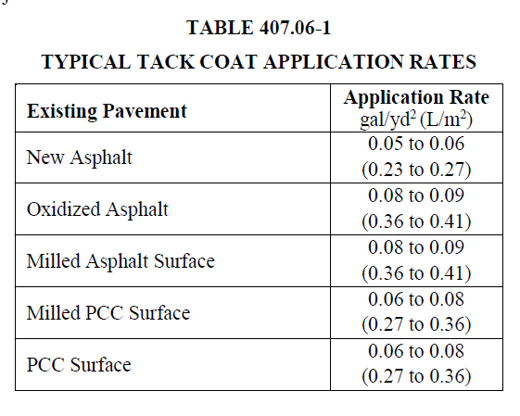
Item 407 – Tack Coat
407.02 Materials
Added 702.12 Non-Tracking Tack Coat.
407.06 Application of Asphalt Materials
Removed allowance to Dilute Tack.
Added Table 407.06-1
Engineer will still set the rate in the field
with table as a guide for the shot rate.
407.06 Basis of Payment
Removed pay item for Tack Coat for
Intermediate courses.

Slide 30
Item 421 - Microsurfacing
421.01 Description
Added 2yr Warranty.
421.04 Weather Limitations
Atmospheric temperature modified to 45°F and rising.
421.05 Mixing Equipment
Clarified Truck-mounted machines to 15,500 square yards or where specified in the plans.
421.08 Surface Preparation.
Remove all existing pavement markings, except 740.02 (traffic paint), using an abrasion method conforming to 641.10. No longer Incidental.
Seal visible joints and cracks longer than 2 feet (600mm) in length according to Item 423. Incidental Work

Slide 31
Item 421 - Microsurfacing
421.10 Application.
If a leveling course and a surface course are specified, apply the paving mixture at 14 ± 2 pounds per square yard for the leveling course, apply the paving mixture at and 16 ± 1 pounds per square yard for the surface course. Apply the two courses at a minimum combined rate of 30 pounds per square yard, regardless of the above tolerances.
If a surface course is specified and it is not placed on a Microsurfacing Leveling Course, apply the paving mixture at a rate of 21 to 24 pounds per square yard.
421.11 Acceptance.
Take binder sample within first hour of placement.
Provide additional samples each day.

Slide 32
Item 421 - Microsurfacing
421.12 Performance Review.
Added 2yr Warranty review criteria and conditions.
421.14 Basis of Payment.
The cost of tack coat and Item 423 Crack Sealing is incidental to Microsurfacing.
Payment for pavement marking removals under Items 643, 644, 645, 646, 647, and 648 as specified.

Slide 33
Item 422 – Chip Seal
422.01 Description
Added 2yr Warranty.
422.02 Materials
Removed RS2 and ADT limits.
Added Type B Gradation.
422.03 Equipment.
Clarified Roller requirements.
422.04 Weather Limitations
Pavement temperature 60°F to 140°F
Atmospheric temperature 70°F minimum.
Moved cutoff date to September 15th.

Slide 34
Item 422 – Chip Seal
422.05 Test Strip.
2/3 Embedment required for cover aggregate.
Added target rates for Type B Gradation.
Added allowance for JMF Adjustment.
422.07 Binder Application.
Added requirement for triple lap coverage
422.09 Construction Operation.
Added requirements for pickup sweepers in curbed areas.
422.10 Quality Control
Contractor to provide daily aggregate split sample to ODOT.

Slide 35
Item 422 – Chip Seal
422.12 Performance Review.
Added 2yr Warranty review criteria and conditions.
Current projects will be waiving warranty requirements by Plan Note.
422.14 Basis of Payment.
Payment for pavement marking removals under Items 643, 644, 645, 646, 647, and 648 as specified.

Slide 36
Item 441 – Asphalt Concrete
441.02 Composition.
Removed Light / Medium / Heavy Traffic Designations.
441 will be used for medium traffic criteria.
Light designs were moved to SS823.
441.13 Acceptance.
The Department will base acceptance of the asphalt concrete mix on the item specified in the Contract item description. (i.e., Item 446, Item 448).
441.14 Basis of Payment.
Added Pay Items with (446/448) reference for acceptance method.
Added Pay Item for Anti-Segregation Equipment.

Slide 37
Item 442 – Superpave Asphalt Concrete
Department will use 442 for all Heavy Traffic applications.
442.08 Basis of Payment.
Added Pay Item for Anti-Segregation Equipment.

Slide 38
450 - Rigid Pavement
451.02 (452) – Materials
Removed QCFS
451.04 (452) – Equipment
Added language prohibiting segregation of the material including air.
Vibration reports mandatory daily submission.
451.17 (452) – Pavement Repairs before Dept. Acceptance
Modified pavement repairs before department acceptance.
Repair plan must be submitted and approved before correction.
455.04.F – Construction Process Requirements
Added tie bar placement and in-place air check monitoring requirements.

Slide 39
Construction - Structures
Jim Welter, P.E.

Slide 40

Structures Specifications Updates for 2016 C&MS
501.04 Shop Drawings and 501.05 Submittal of Working Drawings
Now require competent individuals to prepare and check each page of the submittals,
Ohio Registered P.E. signs, seals and dates the cover sheet or submittal letter confirming submittal meets the intent of the plans.
Notes:
The following changes have been proposed to the 2016 Construction and Material Specifications for the April 15, 2016, Supplemental Specification 800 Boilerplate:
Added “Accepted” and “Accepted as Noted” Working Drawings to Contract Documents.
Added “Engineered Drawings. A type of Working Drawing that requires the practice of engineering as defined in ORC 4733.01(E). Examples of Engineered Drawings include: Excavation Bracing Plans, Demolition Plans, Erection Plans, Falsework Plans, Cofferdam Plans, Causeway Plans, Jacking and Temporary Support Plans, Plans for Heavy Equipment on Structures, Plans for structures for Maintaining Traffic, Corrective Work Plans and Storm Water Pollution Prevention Plans.
Changed definition of Shop Drawings to “Drawings accepted by the Contractor and submitted to the Department that describe portions of the Work fabricated off site that are incorporated permanently with the project. Department acceptance is not required.”
Changed definition of Working Drawings to ”Contractor submitted drawings for work, not otherwise defined in the Bid Documents, that require Department acceptance. Examples of Working Drawings include: Engineered Drawings, installation plans, certified drawings, and any other supplementary plans or similar data that the Contractor is required to submit for acceptance. Accepted Working Drawings are Contract Documents.”

Slide 41
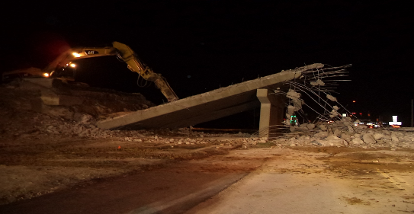
Structures Specifications Updates for 2016 C&MS
501.05 Submittal of Working Drawings
Contractor must submit Working Drawings for the Demolition of the following (either in their entirety or portions thereof) :
    Bridges,
    Culverts with 8 feet or more of fill,
    Walls with 8 feet or more of fill.
Provide method and sequence of removal operations.
Include type and location of equipment.
Notes:
The following changes have been proposed to the 2016 Construction and Material Specifications for the April 15, 2016, Supplemental Specification 800 Boilerplate:
Schedule an Engineered Drawing meeting to be held 7 days, or sooner at the discretion of the Engineer, after submitting railroad accepted drawings to the Engineer.
Attendees shall include the signatory Engineer responsible for the design, the Superintendent, the Engineer and the Inspector.
The purpose of the meeting shall be to review the drawings; resolve all issues to the Engineer’s satisfaction and ensure all parties are in agreement with the work to commence.
At the conclusion of the meeting, the Engineer will provide a written response to the submittal in accordance with C&MS 105.02.
Do not begin work until the Engineer’s acceptance has been received.

Slide 42

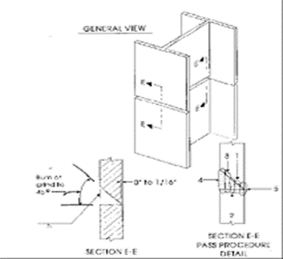
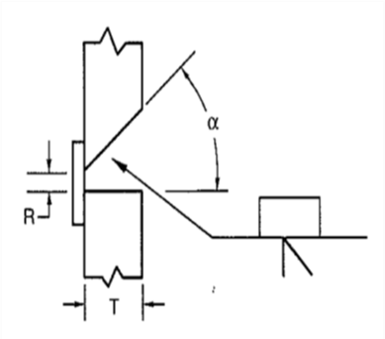
Structures Specifications Updates for 2016 C&MS
507.09 Splices for Piling
Contractor now required to use full penetration butt welds to splice steel pile casings according to AWS D1.1 and structural shapes according to AWS D1.5 .
Non-destructive testing is not required.
Now required to use certified welders for both tube and H piling.
Notes:
AASHTO/AWS D.1.1 Structural Welding Code-Steel for Tubing -(Single Bevel-(45°) Groove Weld(4)- Butt Joint(B) with Backing Spacer(Root Opening 6mm, ¼ inch)
In D1.1 a welder can get certified to weld full-penetration butt welds from one side only on pipe (no backing). D1.5 welders do not have that option.
Designers are using the CIP casing in the lateral moment resistance, This is likely not a major issue in the lower portions of the piles where the applied moment is lower but could potentially be an issue in the upper 10 to 15 ft. of the pile.
90% of piles Axially Compressive.(Wouldn’t need full penetration welds in tube piles, concrete would take load.
If the Axial load is in tension, like in upper 10 to 15 feet of single row of piles in integral abutment, need full penetration welds
AASHTO/AWS D1.5 Bridge Welding Code
Shielded Metal Arc (Stick) Welding –Electrodes E 7018, E 8018

Slide 43
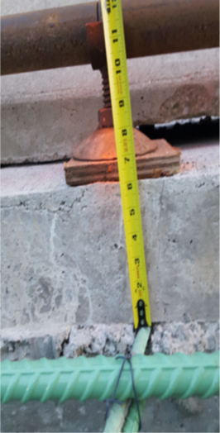
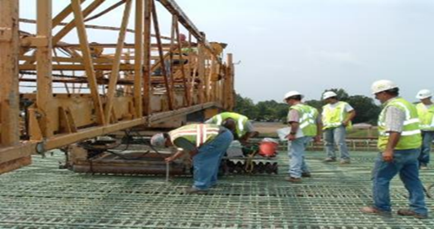
Structures Specifications Updates for 2016 C&MS
509.04 Method of Placing
Deck reinforcement needs to be placed & tied properly,
  (1 ½” to 1 ¾”clearance to bottom concrete of deck,
  2 ¼” to 3 ¼” clearance to top concrete of deck),
  is stable when walked on,
  is free of mud & grease,
  the epoxy coating has not been scratched.
Document dry run of the finishing machine.
Notes:
Always had a minimum coverage, never a maximum coverage in the specifications.
Too much coverage at the top surface of the deck is not acceptable.
Increasing cover has two design consequences:
The crack width at the surface will increase.
The flexural strength of the component will decrease.
Install reinforcing steel with the following clearances from the concrete surface:
A. 2 ½ inches [-0 inch, +0.5 inch] (65 mm [-0 mm, +13 mm]) to the top of sidewalks.
B. 3 inches [-0 inch] (75 mm [-0 mm]) at the faces of footings placed against rock or earth.
C. 1 ½ inches [-0 inch, +0.25 inch] (38 mm [-0 mm, +6 mm]) to the bottom of a cast-in-place deck slab.
D. 2 ½ inches [-0.25 inch, +0.75 inch] (65 mm [-6 mm, +19 mm]) between the reinforcing steel and the top surfaces of cast-in-place concrete deck slabs.
E. 2 inches [-0 inch, +0.5 inch] (50 mm [-0 mm, 13 mm]) at all other surfaces.

Slide 44
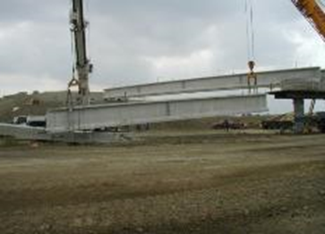
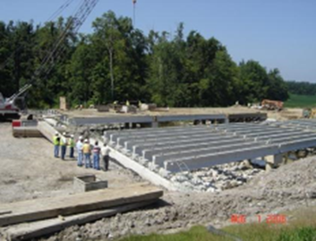
Structures Specifications Updates for 2016 C&MS
511.07 Placing Concrete and 515.18 Prestressed Member Acceptance & Repair
Unless otherwise noted, the proposed beam seat elevations shown in the plans for prestressed beam superstructures are based on the design midspan camber for prestressed beams which are 30 days old (D30).
Adjust each beam seat elevation using measured midspan camber data provided by the fabricator if available.
Notes:
The Department will not accept for shipping, prestressed members with measured camber exceeding the Design Camber (Dt), used to establish the seat elevations, according to 511.07, by more than the Sacrificial Haunch thickness, until a corrective work plan has been approved by the Engineer.
If the prestressed members are acceptable, exclusive of the deviation from Design Camber, the Department will pay for all costs incurred resulting from measured camber exceeding Design Camber calculated for the actual beam age at the time of deck placement, as Extra Work, 109.05.

Slide 45


Structures Specifications Updates for 2016 C&MS
455.03 Structure Quality Control Requirements & 511.07 Placing Concrete
For concrete delivered by means of pumping equipment, ensure the air content at the point of placement is within the specified parameters of Table 499.03-1 and Table 499.03-3.
Adjust the pumping pressure, boom angles and use pumping aids to lower the friction in the piping to meet the specified parameters.
Contractor may take compressive strength samples at point of placement if air content exceeds limits in table 499.03-1 at point of discharge.

Slide 46
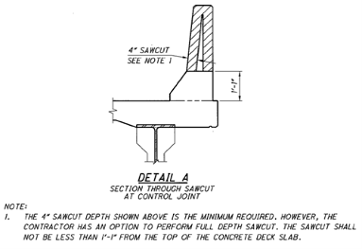
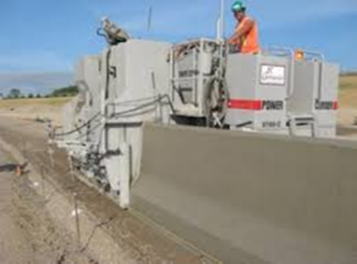
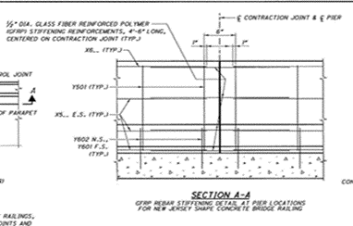
Structures Specifications Updates for 2016 C&MS
511.08 Slipform Construction of Bridge Railing
Bridge Standard Drawings BR-1-13 and SBR-1-13 and SBR-2-13
Eliminated the 2” x 13” aesthetic “Bumpout” on the fascia side of the barrier.
The 1¼” deep sawcut control joint has been replaced with a 4” deep contraction joint.
Glass fiber polymer reinforcement will replace the horizontal epoxy coated reinforcing steel on each side of the plan specified joints.
Notes:
Trying to better control cracking in parapets.
To facilitate this deeper cut, the longitudinal steel at the cut location has been replaced with FRP reinforcement that will provide cage stability during concrete placement without providing a source of corrosion after the barrier is cut. (6 inches on each side of joint).
Joint spacing, joint dimensions and permissible optional conduit locations have also been modified.
At present, we do not utilize the strength of the GFRP. It is only provided to stiffen the reinforcing cage for slip forming. It is then cut completely thru to allow the deck to deflect under load without stressing the barrier. Although ODOT may utilize GFRP for primary reinforcement in the future, there are issues that need to be considered before ODOT is ready to make that decision. One example is the difference is the modulus of elasticity between steel and GFRP and how that affects crash worthiness of the traffic barrier.

Slide 47
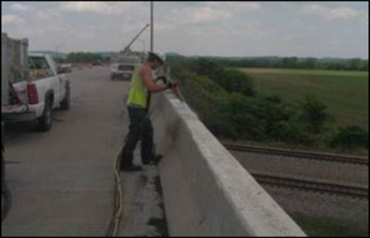
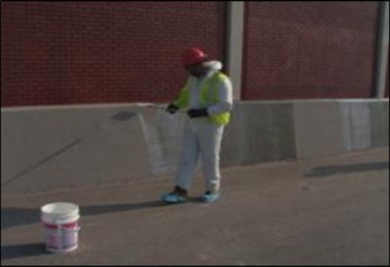
Structures Specifications Updates for 2016 C&MS
512.03 Sealing of Concrete Surfaces Preparation
For non-epoxy, (penetrating) sealers, 100 grit texture not required.
100 grit texture required for Epoxy-Urethane sealers.
Allow combination of water & abrasive blast.
Remove dust, oil, curing compounds, laitance, other coatings.
Document the conditions during application.
Notes:
Don’t apply sealers if it is below 50◦F, within 5◦F of dew point, or Relative Humidity is 80% or above
For SRS on bridge decks, now requiring abrasive blast.

Slide 48

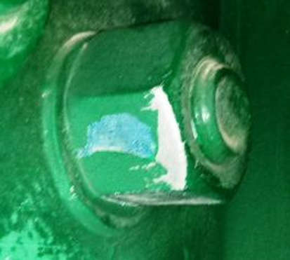
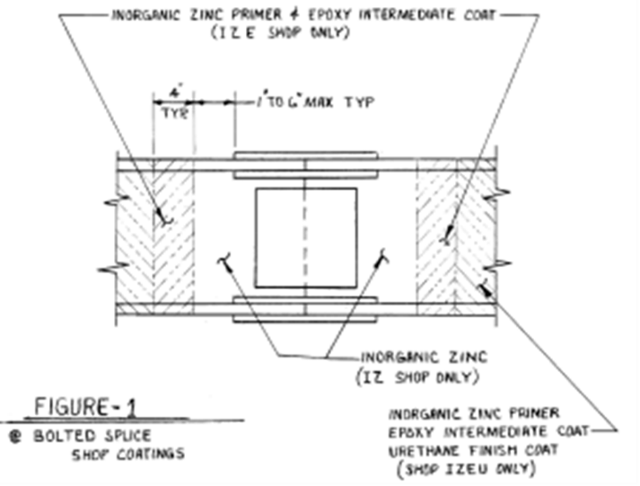
Structures Specifications Updates for 2016 C&MS
514.07 Structural Steel Coating Application
Added descriptions for coating of bolted connections and faying surfaces.
Notes:
Repair damage to the paint system caused during storage, transportation, erection, bolting, welding, forming, concrete placement, and form removal operation, according to C.&.M.S. section 514.22. Repair damage to the galvanized coating on the nuts, bolts and washers, in the field due to the bolt tightening or welding operations.

Slide 49
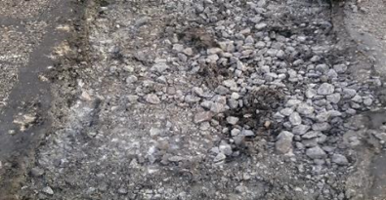
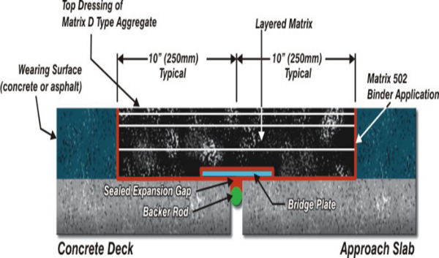
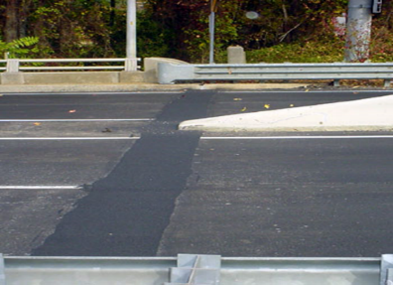
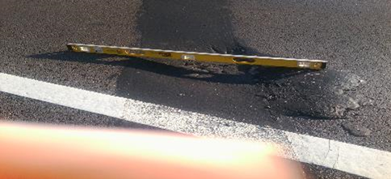
Structures Specifications Updates for 2016 C&MS
SS 846 Polymer Modified Expansion Joint System
Contractor needs to submit site specific installation plan.
Patch unsound concrete prior to installation.
Use specified proportions of coarse and fine aggregate.
Use specified proportion of A/C.
Notes:
Replaces old Structural Engineering plan insert sheet
No longer requires Material Supplier Representative to be present during installation

Slide 50
Construction – Traffic and Roadway
Dan Groh, P.E.

Slide 51
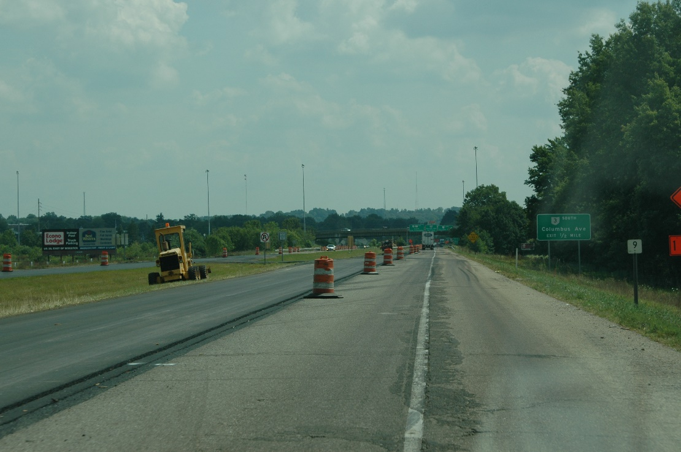
Storage of Equipment, Vehicles and Material on Highway Rights-of-Way
6 feet behind the face of Existing Barrier and not within the 75 foot long by 20 foot wide Recovery Area
  Not less than 30 feet from the nearest edge of the traveled way, or;
  At least 6 feet behind raised curbs.
  Additionally, at night, encompass any such equipment, vehicles or material with drums, equipped with Type A warning lights, spaced at 5 feet on center.
Notes:
If equipment, vehicles, and material are stored or parked on highway rights-of way, locate them not less than 6 feet (2 m) behind existing guardrail or not less than 30 feet (9 m) beyond the traveled way unless otherwise permitted by the Engineer. At night if any such material or equipment is stored between the side ditches, or between lines 6 feet (2 m) behind any raised curbs, clearly outline them with dependable lighted devices that are approved by the Engineer.
Unless otherwise permitted by the Engineer, locate all equipment, vehicles, and material stored or parked on highway rights-of-way:
A. At least 6 feet behind the face of Existing Barrier and not within the 75 footlong by 20 foot wide Recovery Area behind the Existing Barrier run, or;
B. Not less than 30 feet from the nearest edge of the traveled way, or;
C. At least 6 feet behind raised curbs.
Additionally, at night, encompass any such equipment, vehicles or material with drums, equipped with Type A warning lights, spaced at 5 feet on center. For locations with traffic approaching from more than one direction or side (e.g., medians, between mainline and ramps, etc.), ensure the requirements are met for all traffic approaches. Existing Barrier, for purposes of 614.035 only, includes and is limited to: existing permanent guardrail, existing concrete barrier, temporary or new permanent guardrail installed in accordance with the plans, temporary portable barrier installed in accordance with the plans, or new permanent concrete barrier installed in accordance with the plans. Other types of barrier not listed, such as cable barrier, are excluded as a means of protecting drivers from stored equipment, vehicles and material on highway rights-of-way. Recovery Area, for purposes of 614.035, shall have slopes 3:1 or flatter and be free of workers, hazards, equipment, vehicles, drop-offs, and material storage. The Recovery Area length is to begin at the terminus of the Existing Barrier run. Any gating impact attenuator length shall not be included as part of the Recovery Area length.

Slide 52
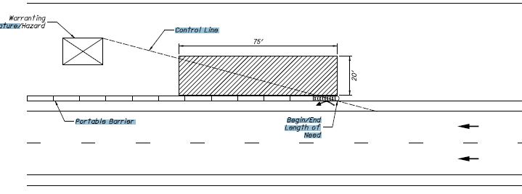
Storage of Equipment, Vehicles and Material on Highway Rights-of-Way

Slide 53
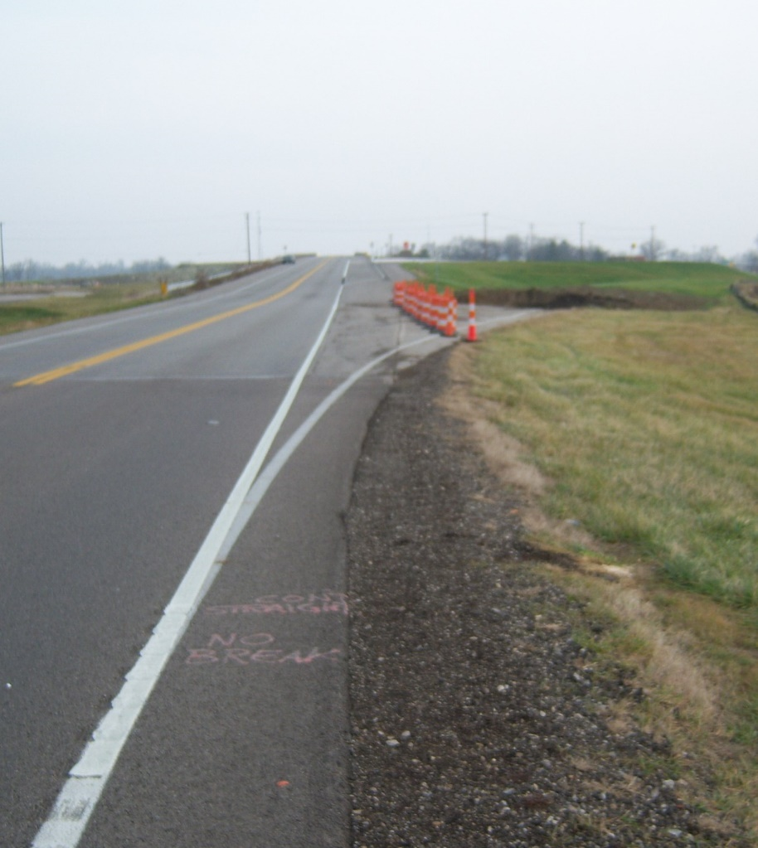
Conflicting Markings
Conflicting markings:
  considered to be any markings not actively in use,
  not behind channelizing devices or portable barrier and/or,
  could be misinterpreted by the traveling public or,
  cause confusion to the driver as determined by the engineer.
Before placing work zone markings, remove or cover all conflicting existing markings visible to the traveling public.

Slide 54

Automated Flagging Assistance Device
The Contractor may (supplemental to using flaggers) furnish, install, maintain and operate automated flagger assistance devices (AFADs) with incidental items, for the purpose of assisting the flagger(s) in regulating traffic according to a written agreement approved by the Engineer. AFADs shall be furnished per the Department’s Approved List and shall be used in accordance with Supplemental Specification 830.
Notes:
The Contractor may (supplemental to using flaggers) furnish, install, maintain and operate automated flagger assistance devices (AFADs) with incidental items, for the purpose of assisting the flagger(s) in regulating traffic according to a written agreement approved by the Engineer. AFADs shall be furnished per the Department’s Approved List and shall be used in accordance with Supplemental Specification 830.

Slide 55
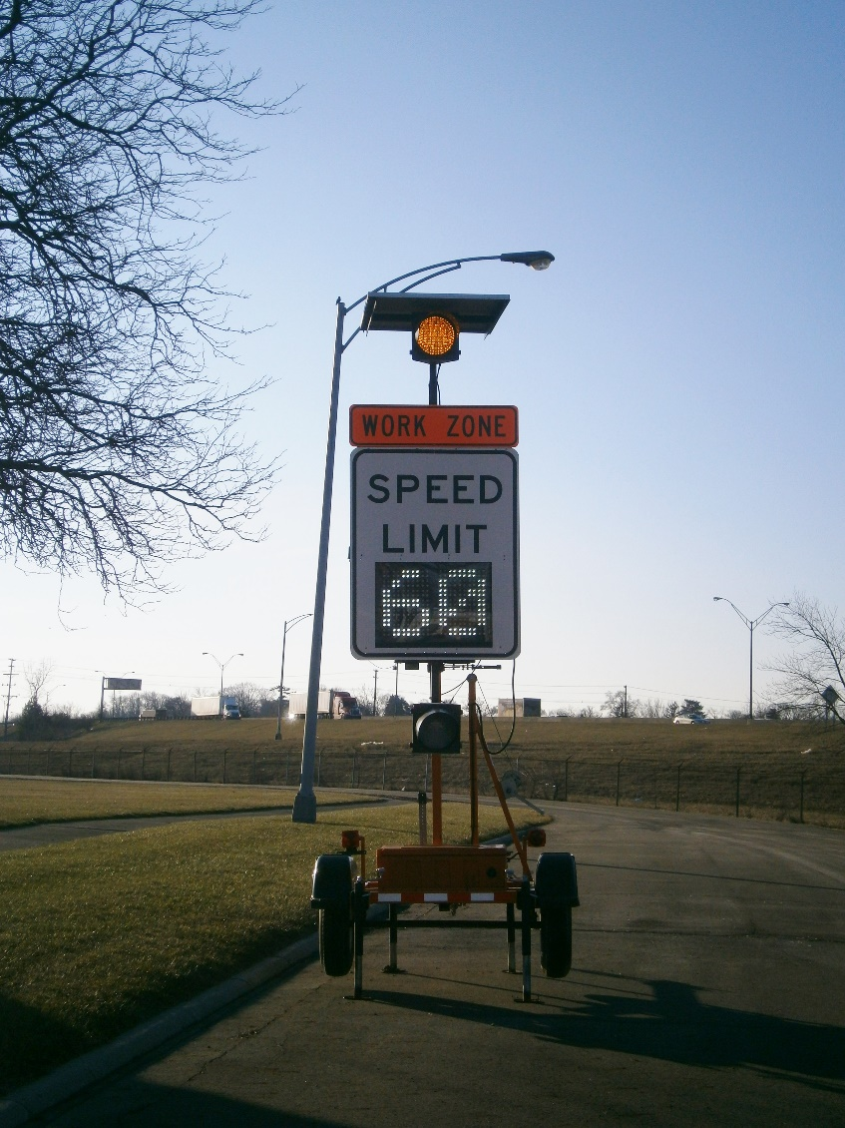
SS 808 Digital Speed Limit Assemblies
The spec is approved
There is currently 1 approved supplier
There may be plans sold with flat sheet signs as the method for varying speed due to availability of the DSL assemblies
Designers should be inserting this spec into plans
Contractors (and designers) make sure the DSL assemblies are available, if not, ask prebid question for a change back to flat sheet signs

Slide 56
Data Logger System
Add on to current datalogger equipment
Allows for direct transmittal from manufacturer of equipment to ODOT personnel and contractor personnel simultaneously.
Currently for district wide 642 paint projects only
Moving to standardization for all projects by October update
Notes:
PN 640 – 05/08/2015 – REVISIONS TO THE 2013 C&MS FOR ADDITIONAL DATA LOGGING SYSTEM REQUIREMENTS FOR PERMANENT WATER-BASED TRAFFIC PAINT
641.04 On Page 606 Delete the entire subsection.
642.01 On Page 610 Add the following paragraph after the first paragraph
Provide equipment containing a Data Logging System (DLS) for long line water-based striping trucks. The DLS will record operational details during striping operations, store data, generate reports, and export to a secure server on a daily basis.
642.03 On Page 611, Replace paragraphs two and three with the following,
Equipment Requirements. Equip long line striping trucks for this project with a DLS that meets the following requirements:
1. Operational Requirements.
A. Measures and records application vehicle speed to nearest 0.1 mile per hour (MPH).
B. Measures and records weight in pounds (LBS) and/or volume in gallons (Gals) of binder as measured through a positive displacement pump mechanism, a flow meter or load cells under the material tanks.
C. Measures and records weight in LBS of reflective glass beads/elements used as measured with load cells under the bead/element tanks.
D. Measures and records pavement surface temperature (Degrees F).
E. Measures and records air temperature (Degrees F).
F. Measures and records dew point (Degrees F).
G. Measures and records humidity (Percent).
H. Calculates and records average material application rates and film thicknesses over each segment painted.
I. Provides the highway number with the beginning and ending reference points rounded to the nearest thousandths of a mile, the beginning and ending coordinates determined by a Global Positioning System receiver with 16 foot accuracy, and the direction of travel in terms of increasing or decreasing reference points.
J. Provides cellular capabilities for field data transport to website.
2. Documentation Requirements.
A. Date and beginning and ending time of application.
B. Vendor and product (binder and reflective material).
C. Lot number(s) of product used.
D. Specific weight of binder lot(s) used in pounds per gallon (LBS/Gals).
E. Striping contractor.
F. Designation of the marking being applied (LEL – Left Edge Line, REL – Right Edge Line, CL – Centerline, LL – Lane Line).
G. Width of marking being applied.
H. Application vehicle speed to the nearest 0.1 MPH.
I. Weight in LBS and/or volume in Gals of binder used by color as measured per the requirements in subsection 1.B of this proposal note.
J. Weight in LBS of reflective glass beads/elements used as measured per the requirements in subsection 1.C of this proposal note.
K. Pavement surface temperature (Degrees F).
L. Air temperature (Degrees F).
M. Dew point (Degrees F).
N. Humidity (Percent).
O. The system must calculate and report average material application rates and film thicknesses over each segment painted.
P. The system must report the total footages painted for each segment broken down by line color and width (e.g. – total 4 inch yellow in segment, total 6 inch white in segment, etc.).
Q. Provide the highway number with the beginning and ending reference points rounded to the nearest thousandths of a mile, the beginning and ending coordinates determined by a Global Positioning System receiver with 16 foot accuracy, and the direction of travel in terms of increasing or decreasing reference points.
R. Provide GPS mapping system that is capable of real time (within 20 minutes) tracking of material application rates, film thickness, beads pounds per gallon, vehicle speed, time, date, project numbers, operator manual data, and color coded alarms for film thickness. Film thickness alarms must have a tolerance of ±0.5 mils.
S. Provide access to stored data on a secure password protected website.
The system must record and report the average material application rates for paint and beads on a road by road basis. Each road (segment) will be evaluated over an entire control section (CS) in increments of 5 miles. When the control section is less than 5 miles long, it will be evaluated over its entire length and considered a segment. Control sections greater than 5 miles long, will be broken into 5 mile segments, (e.g. A control section 20 miles long would have 4 segments each 5 miles long, a control section that is 17 miles long would have 3 – 5 mile long segments, and 1 – 2 mile long segment). At the beginning/end of each control section ensure the material is settled in the tanks prior to logging the system information; it may be necessary to bring the truck to a full stop for 5-10 seconds to achieve settling if the roadway contains hills, curves, or bumps.
Ensure the DLS is operational, calibrated and in use during pavement marking operations. Collect data for any non-handwork longitudinal pavement marking application of 0.5 mile (drive length) or greater. Completion of work for the individual day will be permitted if the DLS equipment fails. Provide documentation of the corrective work that was required to make the DLS and ancillary equipment operational as approved by the Engineer before resuming work. Document the application and material usage quantities from the time of the DLS failure, and make calculations to determine the gallons of binder per mile and pounds of beads per mile. Repair the DLS before resuming work, or as approved by the Engineer.
Provide the Engineer the DLS manufacturer’s recommendations for equipment calibration frequency and provide certification that the equipment meets manufacturer’s recommended calibration. Ensure a signed DLS calibration sticker is present in the driver’s door and carries a date of the current calendar year prior to the DLS system being placed into use for the season. Calibrate every DLS a minimum of once each year.
Materials. Furnish materials from the ODOT Approved found at http://www.dot.state.oh.us/Divisions/ConstructionMgt/Materials/Approved-List/Pages/default.aspx
Construction. The Engineer may randomly perform field verifications of the DLS operation and calibration at any time to ensure the accuracy of the DLS data and output. If field personnel believe that the DLS data and output is not accurate, then additional checks may be performed. Provide DLS equipment certified by the manufacturer.
The Department will provide a standard DLS short form and long form, which prescribes the correct DLS report format and content prior to beginning of work.
On the first working day following application of markings requiring documentation with the DLS or upon demand, furnish the Engineer a copy of the DLS report in ODOT DLS short report format. The DLS report can be provided in one of the following methods, which should be agreed upon at the preconstruction meeting:
1. E-mail of Excel spreadsheet file.
2. Disk or flash drive transfer of Excel spreadsheet file.
Within two weeks of the date of application of markings requiring documentation with the DLS, furnish the Engineer the Excel spreadsheet file of the DLS report in ODOT DLS long report format by e-mail at the e-mail address provided at the preconstruction meeting.
At the end of the project, furnish the Engineer all electronic Excel spreadsheet files in ODOT DLS long report format.
Reporting. The DLS must store data and export to a secure server on a daily basis. Ensure the data is in Microsoft Excel format, or a comma or spaces delimited text file adequate for insertion into a computerized spreadsheet. Ensure the data is available to the Engineer within 24 hours of the pavement marking work and may be retrieved by the Engineer or designated field personnel for inclusion with documentation reporting. Ensure the electronic records are completed in their final form prior to the records being removed from the pavement marking equipment.
Provide the GPS mapping information as detailed in subsection 2.R of this proposal note to the Engineer on a weekly basis. Provide the data in a CSV file formatted for importation into and use with ArcGIS version 10.1.
Designer Note. This note will only be used on district wide water based traffic paint projects with the written authorization of the Office of Construction Administration.

